Slide 1
CSCI 2200: Intro to Unix
Vim

Slide 2
In the beginning…
  There was ed … single line editor
  Then came ex … had a nifty visual mode
  Visual mode lead to vi
  Written by Bill Joy in 1976
  vi is a Unix utility - so we need a free clone
  - elvis, nvi, vile, vim

Slide 3
Vim (Vi Improved)
  Written by Bram Mooleanaar
  Packaged with most (if not all) Linux distros
  vi is aliased to vim
  Available also from www.vim.org
  -gVim, multi-platform

Slide 4
Vim (Vi Improved)
  Powerful, quick text editor
  Excellent for programming due to intelligent language detection
  Plain text only
  Tons of options and commands

Slide 5
Starting Vim
  Syntax
  vim [options] [filename]
  filename is optional
  - With it, creates file and opens it for editing (The file isn’t actually created until content is added and saved)
  - Without it, opens a default screen

Slide 6
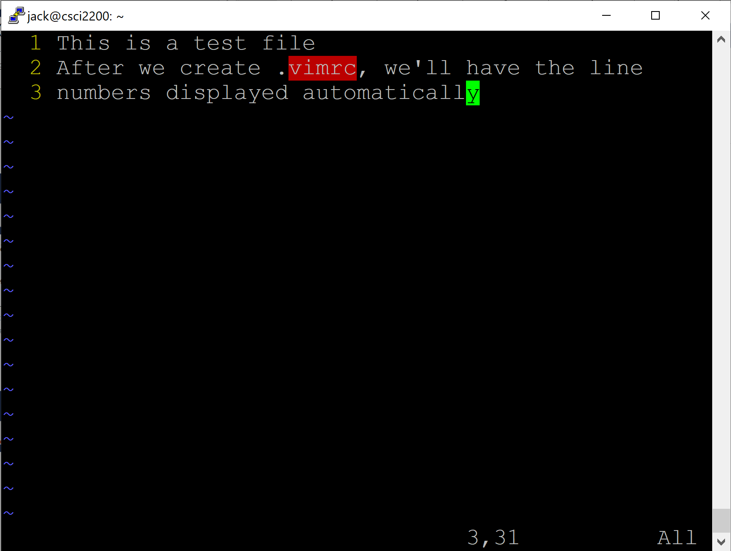
<Title>
Line numbers
Cursor
With long files, this will show your approximate position within the file
Tildes represent empty lines
Current column
Last line
Current line

Slide 7
How it works
  vim copies the contents of the file you want to edit into memory
  Referred to as the Work Buffer
  Changes are made to the buffer (again, in memory), not the file
  The file itself isn’t updated (changed) until you write the changes to it
  :w or :wq

Slide 8
Modes
  Command (sometimes referred to as Normal)
  This is where you start. Can’t enter text, yet
  <ESC> will return to Command Mode (but we’re going to change that soon
  Input
  This is where you can input text
  Last line
  Manage files, shell commands, change settings
  Visual
  Allows selection of multiple characters/lines

Slide 9
Command Mode
  Again, this is the default mode
  Used to enter commands for
  - Text manipulation
  - Changing modes
  - Changing settings (e.g., :set number)
  - Saving / exiting
  Most commands are just alpha characters, not control sequences
  Case sensitive

Slide 10
Insert Mode
  Allows entering and editing text
  Several sub-modes
  - Insert
  - Append
  - Open
  - Replace
  - Change
  This is where you’ll hang your hat, mostly

Slide 11
Last Line Mode
  From Command Mode, press :
  Cursor jumps to the last line on the display
  Here, you can manage files, issue shell commands, change editor settings
  Also save/save & exit

Slide 12
Command Mode Navigation
  ^
  < >
k
It’s weird at first, but you get used to it
The arrow keys work, too. But the point is to remove your hands from the keyboard as little as possible
h
l
j
^

Slide 13
Command Mode Editing
  i insert text after cursor position
  a append text to line (doesn’t matter where the cursor is)
  rletter replace the letter under the cursor with letter
  x delete character (under the cursor)
  ce change from cursor to end of a word
  c$ change from cursor to end of line
  dw delete word (cursor at beginning of word)
  dd delete line

Slide 14
Command Mode Editing
  y copy (yank) selected text
  p paste (put) yanked text elsewhere
  u undo the last action
  Ctrl+R redo the last undo

Slide 15
Command Mode Other
  e move cursor to the beginning of the next word
  ^ or 0 move cursor to the beginning of the current line
  $ move cursor to the end of the current line
  o open a line below the cursor & place in Insert mode
  O open a line above the cursor & place in Insert mode
  /regex search for regex forward
  ?regex search backward
  n repeat last search (find next result)
  N repeat last search in the opposite direction

Slide 16
Command Mode Other
  G go to the end of the file
  gg go to the start of the file
  nG jump to line n
  Ctrl-G shows location in file
  :w write file
  :q quit
  :w! write read-only file
  :q! quit without saving changes
  :e filename opens a file for editing

Slide 17
Command Mode Other
  :sh Open a shell (‘exit’ to return)
  ! cmd Open a shell, run a command, and exit the shell

Slide 18
Exiting Vim
  One of the first things to know about Vim is how to get out of it
  (In command mode)
  :q exit (no changes; will fail if there are changes not saved)
  :q! exit without saving
  :wq save & exit
  ZZ save & exit

Slide 19
Searching
  In Command Mode, enter / followed by a pattern (regular expression), i.e.:
  /[pattern]
  For example,
  /foo
  will search for the next occurrence of the pattern foo within the file
  Use n to look for the next occurrence / N to search for the last
  By default, will wrap top-to-bottom or bottom-to-top

Slide 20
Matching Parentheses
  Vim is often used for writing code. As such, it is often beneficial to be able to locate a (, [, or {‘s mate
  If we place the cursor on one, pressing
  %
  will move the cursor to its corresponding (opening or closing) paren

Slide 21
Substitution
  In Command Mode,
  :s/old/new
  will search for old and replace the first occurrence of old with new
  :s/old/new/g
  will replace all occurrences of old with new
  :#1,#2s/old/new/g
  will replace all occurrences of old between lines #1 and #2 with new, e.g.,
  :10,20s/old/new/g

Slide 22
Getting Help
  In Command Mode, enter
  :help
  Enter :q to exit help
  Search for help on a specific topic by adding it to :help
  :help w

Slide 23
Buffers
  Work buffer
  General Purpose Buffer (like the Windows clipboard)
  Named buffers
  Numbered buffers

Slide 24
GP Buffer
  Contains recently edited or deleted (cut) text
  Stores ‘undo’ information
  Stores yanked text

Slide 25
Named Buffers
  Similar to GP buffer
  Doesn’t contain undo info, only text that’s placed there
  26 - referenced by letters a-z

Slide 26
Numbered Buffers
  Numbered 1-9
  Read only
  Contain most recently deleted chunks of data greater than one line long
  Can paste (put) from these buffers and use them for undoing deletes

Slide 27
yank
  Copies lines of text
  To yank a whole line, use yy or Y
  To yank multiple lines, place cursor on the first and use nY, where n is the number of lines to yank
  By default, yanks stored in the GP Buffer
  To use a named buffer, precede the yank command with double quotes and the letter of the buffer, e.g., "ay

Slide 28
put
  Pastes text from a buffer into the Work Buffer
  Use p to put below current line
  Use P to put above the current line
  Again, if using a named buffer, precede with double quotes

Slide 29
Operators & Motions
  Many commands that change text are made by use of an operator and a motion
  [op] [motion]
  - op == operator
  - motion == what the operator will operate on
  E.g.:
  d3w
  will delete the first three words following the cursor

Slide 30
Operators & Motions
  Examples:
  2w move the cursor two words forward
  3e move the cursor to the end of the 3rd word forward
  2dd delete the line at the cursor and the next line
  d2w delete the next two words
  0 move to the start of the line

Slide 31
vimtutor
  A great way to sharpen your vim skills
  Starting out with vim, you probably won’t use all of these features
  I still end up using the arrow keys, for example, instead of h,j,k,l to position the cursor
  But, as you use it more and more, the convenience of a lot of the above commands/motions becomes more evident
  To use the tutor, simply enter vimtutor at the command prompt
  The instructions are included in the file that is then loaded

Slide 32
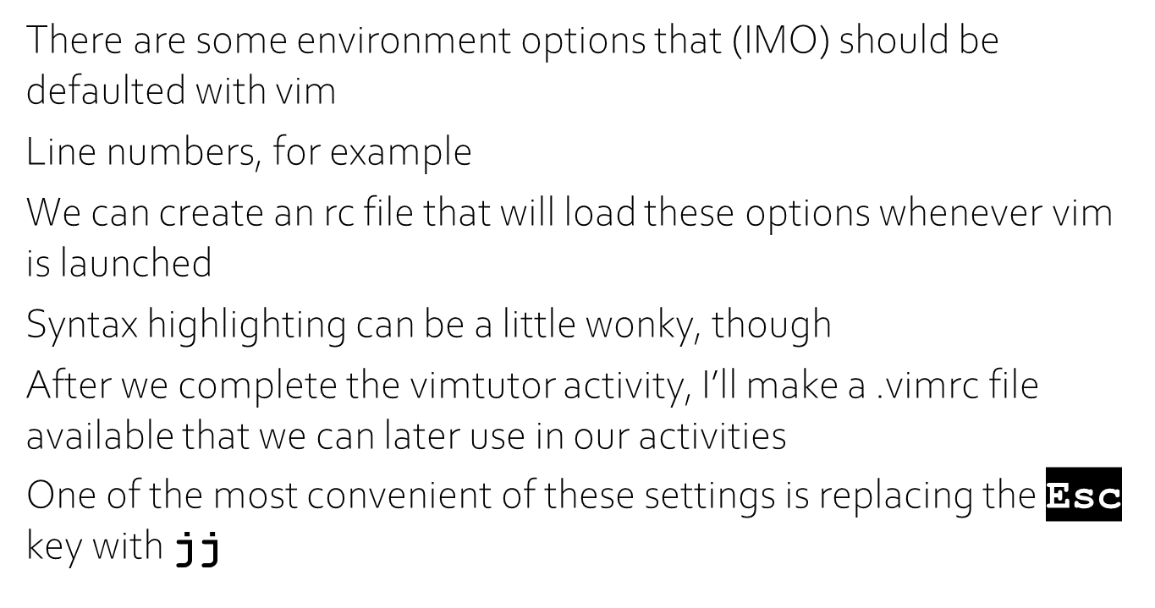
.vimrc

Slide 33
Title

Slide 34
Title

Slide 35
Title

Slide 36
Title

Slide 37
Title

Slide 38
Title

Slide 39
Title

Slide 40
Title

Slide 41
Title

Slide 42
Title

Slide 43
Title

Slide 44
Title

Slide 45
Title

Slide 46
Title

Slide 47
Title

Slide 48
Title

Slide 49
Title

Slide 50
Title

Slide 51
Title

Slide 52
Title

Slide 53
Title

Slide 54
Title

Slide 55
Title

Slide 56
Title

Slide 57
Title

Slide 58
Title

Slide 59
Title

Slide 60
Title

Slide 61
Title

Slide 62
Title

Slide 63
Title

Slide 64


